Slide 1
Robert Gish MD
Medical director of Hepatitis B Foundation
HDV
Where do we go with double reflex testing ?

Slide 2
Disclosures : robertgish.com

Slide 3
The success of HDV reflex testing has been shown in
NYC
Spain
England
France
…………..

Slide 4
RECOMMENDATIONS AND RATIONALE – HDV testing - Who to test?
New recommendations
Universal testing approach
Serological testing for anti-HDV antibodies may be performed for all individuals who are HBsAg positive, as the preferred approach to scale up access to HDV diagnosis and linkage to care
(conditional recommendation, very-low-certainty evidence)
Priority population testing approach
In settings in which a universal anti-HDV antibody testing approach is not feasible because laboratory capacity or other resources are limited, testing for anti-HDV may be given priority in specific populations of HBsAg-positive individuals:
people born in HDV-endemic countries, regions and areas;
people with advanced liver disease, those receiving hepB treatment; and those with features suggesting HDV infection (such as low HBV DNA with high ALT levels); and
people considered to have increased risk of HDV infection (haemodialysis recipients, people living with HCV or HIV, people who inject drugs, sex workers and men who have sex with men).
(conditional recommendation, very-low-certainty evidence)
Narrative review
No studies directly evaluated impact and cost-effectiveness of different anti-HDV testing approaches.
Observational studies from high income settings show poor testing uptake and case-finding based on risk-based approach, and marked increase with laboratory-based universal anti-HDV testing
Effective case-finding crucial to implement preventative interventions eg. enhanced HCC surveillance, and access new treatment options

Slide 5
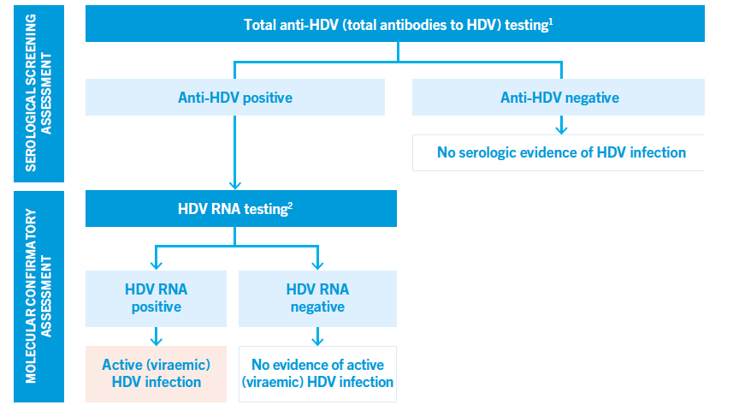
RECOMMENDATIONS – HDV testing How to test?
Diagnostic pathway
People with CHB (HBsAg positive) may be diagnosed with hepatitis D by using a serological assay to detect total anti-HDV followed by an NAT to detect HDV RNA and active (viraemic) infection among those who are anti-HDV positive.
Assays should meet minimum quality, safety and performance standards.
(conditional recommendation, low-certainty evidence)
Available commercial anti-HDV and molecular PCR assays have good diagnostic accuracy and correlate well with one another.
Key limitation is lack of established gold standard assays and of an RDT for anti-HDV antibody.
Reflex testing
Reflex testing for anti-HDV antibody testing following a positive HBsAg test result and also for HDV RNA testing (where available) following a positive anti-HDV antibody test result, may be used as an additional strategy to promote diagnosis.
(conditional recommendation, low-certainty evidence)
Systematic review of reflex testing
11 studies of reflex anti-HDV Ab testing (3 had non-reflex comparator arm) in those HBsAg positive
Increased uptake of serology testing (97% (95% CI: 92–100%) vs. 45% (95% CI: 0.3–98%) vs. non-reflex testing
Very high uptake of reflex HDV RNA in those anti-HDV positive - 98% (95% CI: 77–100%) in 8 studies.

Slide 6
There are Unmet Needs Across the HDV Care Cascade
‡
Infected
Screened
Diagnosed
Managed
Treated
Lack of robust data
Number with HDV unknown
Test availability
Standardized screening tests required
Protocol for testing HDV in HBsAg-positive patients required
Need for surveillance protocols to detect rapid disease progression
Lack of specific treatment options until recently
Need for clarity on which stage of disease to treat patients
Stockdale AJ, et al. J Hepatol 2020;73:523-3; Miao Z, et al. J Infect Dis 2020;221:1677-87;
Shah P A, et al. Gastroenterol Rep 2019;7:396-402.
HDV: hepatitis D virus; HBsAg: hepatitis B surface antigen.

Slide 7
HDV Screening Occurs Inconsistently in HBV Patients Despite the Known Risk of Co-infection/Superinfection
‡
4.5-13% of HBV carriers
are co-infected with HDV^{1,2}
1. Miao Z, et al. J Infect Dis 2020;221:1677-87; 2. Stockdale AJ, et al. J Hepatol 2020;73:523-3;
3. Safaie P, et al. Virus Res 2018;250:114-7; 4. Kushner T, et al. J Hepatol 2015;63:586-92;
5. Bouzidi KE, et al. J Clin Virol 2015;66:33-7.
CHB: chronic hepatitis B virus; HBsAg: hepatitis B surface antigen; HBV: hepatitis B virus;
HDV: hepatitis D virus; HIV: human immunodeficiency virus.

Slide 8

‡
Mount Sinai Hospital
HDV Screening and Disease Burden in a US Center
Retrospective analysis evaluating screening patterns, patient characteristics
and outcomes in HDV from January 2016 to October 2021
HDV Screening Patterns
Anti-HDV+ Individuals
Liver-Related Events (2016–2021)
11,110 individuals
with CHB
Characteristics at Time of Anti-HDV Testing | n=72
Age at diagnosis, mean | 48
Male, n (%) | 45 (63)
Cirrhosis, n (%) | 40 (56)
Comorbidities, %
HCV | 11
HIV | 8
NAFLD | 7
No HDV screening n=9,720 (87%)
Anti-HDV screening n=1,390 (13%)
15/72
11/72
15/72
Anti-HDV−
n=1,302 (94%)
Anti-HDV+
n=88 (6%)*
Liver
decompensation†
HCC
Needed Liver transplant
2/72 (3%) individuals died
Despite high morbidity associated with HDV, only 13% of HBV were screened for HDV;
universal screening for HDV among HBsAg carriers may be reasonable
*72 patients had complete information on chart review and were included in the analyses; †Ascites, esophageal varices, hepatic encephalopathy.
Nathani R, et al. EASL 2022. Poster #THU392

Slide 9

HDV Screening at University Hospital of Bordeaux
‡
Evaluation of the number of chronic HBV individuals with available HDV screening and HDV RNA testing
from October 2018 to May 2021
HBsAg screening
n=46,443
HBsAg screening
HDV Ab screening
Screening for HDV is suboptimal in a viral hepatitis expert center
51% of HBsAg+ patients were not screened for HDV Ab
Health policy initiatives are needed to improve HDV screening and include reflex testing
HBsAg+
n=988 (2.13%)
HDV RNA testing
No HDV Ab screening
n=505 (51%)
HDV Ab screening
n=483 (49%)
HDV Ab+
n=50 (10%)
HDV Ab-
n=433 (90%)
No HDV RNA test
n=11 (22%)
HDV RNA test
n=39 (78%)
16 (41%) patients were HDV RNA+
HDV Anti-HDV tests used: Liaison XL Murex anti-HDV, DiaSorin; HDV RNA tests used: EurobioPlex HDV, Eurobio
Trimoulet P, et al. AASLD 2021. 720

Slide 10

Screening of HDV in HBsAg+ Patients in Barcelona – Are EASL Guidelines Implemented?
‡
Barcelona: 1 Academic Hospital and 65 Primary Care Centers
Retrospective analysis of HBsAg+ serum samples from a central laboratory in January 2015 to May 2021
HDV Screening Cascade
HDV Ab Screening in Academic and Primary Care
Post EASL Guidelines 2017
HBsAg screening
HBsAg+
n=4,385
HDV Ab screening
HDV RNA testing
No HDV Ab screening
n=4,025 (92%)
HDV Ab screening
n=360 (8%)
HDV Ab+
n=37 (10%)
HDV Ab-
n=323 (90%)
27%
9.4%
118/436
3.2%
No HDV RNA test
n=6 (16%)
HDV RNA test
n=31 (84%)
157/1673
39/1237
Despite guidelines being in place, a large proportion of HBsAg+ individuals remains untested for HDV.
New strategies and education on reflex testing should be considered
*1457 (33%) and 2929 (67%) of HBsAg+ samples came from academic hospitals and primary care centers respectively
282 (78%) and 78 (22%) of anti-HDV requests came from academic hospitals and primary care centers, respectively
EASL guidelines recommendations for HDV screening did not differ pre-2017.
Palom A, et al. AASLD 2021. Oral 224

Slide 11












‡
Challenges and Potential Solutions to Screening
Challenges
Potential Solutions
HDV endemicity remains unclear due to limited studies and inconsistent reporting in populations of CHB patients.^{1,2}
Universally screen all HBsAg⁺ patients.
Include routine HBV testing on the US immigration medical exam.
Recommendations for risk-based screening fail to identify patients due to poor clinician awareness of risk groups.²
Include hepatitis delta as a disease reportable to the CDC.
Poor clinician and patient awareness of HDV screening, diagnosis and prevention.^{2,3}
Provide educational initiatives for provider awareness, as well as targeted, patient-centered education on hepatitis delta.
Barriers to care in high-risk populations exist, including access to doctors.³
Increase access to HBV vaccinations, testing, and care.
Screening guidance recommendations vary and are based on provider discretion.⁴⁻⁷
Develop HDV-specific screening guidelines.
Implement anti-HDV reflex testing.
Reliability of laboratory derived tests (LDTs) vary between tests and across genotypes.^{8–10}
Evaluate the appropriate LLoD for HDV RNA assays.
Design HDV RNA tests with sensitivity to non-HDV-1 genotypes.
Due to underreporting of HDV, poor clinician awareness, and challenges in screening for hepatitis delta, solutions such as universal testing of HBsAg⁺ patients and anti-HDV reflex testing have been proposed.
Anti-HDV: HDV antibody; CDC: Centers for Disease Control and Prevention; CHB: chronic hepatitis B; HBsAg: hepatitis B surface antigen; HBV: hepatitis B virus; HDV: hepatitis delta virus; LLoD: lower limit of detection; RNA: ribonucleic acid.
References: 1. Miao Z, et al. J Infect Dis. 2020.221:1677-1687. 2. Terrault NA and Ghany MG. Dig Dis Sci. 2021.66(8):2483-2485. 3. Kumar P, et al. Prev Chronic Dis 2020. 159(17) 4. Terrault NA, et al. Hepatology. 2018. 67(4):1560-1599. 5. Sarin S, et al. Hepatology Int. 2016.10(1):1-98. 6. EASL. Journal of Hep. 2012.57(1):167-185. 7. World Health Organization. 2015. 8. Brichler S, et al. Clinical Gastroenterology and Hepatology. 2013.11(6):734-740. 9. Brichler S, et al. Journal of Clinical Microbiology. 2014.52(5):1694-1697. 10. Le Gal F, et al. Hepatology. 2016.64(5):1483-1494.

Slide 12

HBsAg-Positive Reflex to Anti-HDV
‡
Cross-sectional analysis of HDV testing among HBsAg-positive patients at 2 London Centers, 2005-2012
HDV Testing Based on Provider Discretion or Reflex
100
99.4
Provider discretion
Reflex
80
60
Patients (%)
40.0
40
20
67
168
3543
3563
<1.0
4.5
<1.0
<1.0
0
HDV Tested
Anti-HDV
HDV RNA Positive
Center with a reflex laboratory algorithm achieved anti-HDV testing of almost all first HBsAg-positive samples over a 12-yr period
El Bouzidi. J Clin Virol. 2015;66:33.
Notes:
HBsAg, hepatitis B surface antigen; HDV, hepatitis delta virus.

Slide 13
‡
Implementation of HDV Reflex Testing in
HBsAg+ Patients
Analysis of HBsAg+ samples before and after anti-HDV reflex test implementation in an academic hospital and 17 primary care centers
HDV Screening Cascade¹
Anti-HDV+ Cases Detected²
Pre reflex test
(2018–2020)
Post reflex test
(Jan–Dec 2021)
HBsAg+
Anti-HDV screened
Anti-HDV+
HBsAg+
n=1,492
HBsAg+
n=744
No HDV
screening (92%)
Anti-HDV screening (8%)
No HDV
screening (7%)
Anti-HDV screening (93%)
Anti-HDV−
n=103 (90%)
Anti-HDV+
n=11 (10%)
Anti-HDV−
n=635 (92%)
Anti-HDV+
n=56 (8%)
HDV RNA+
n=35 (70%*)
Pre-reflex
Reflex test
Implementation of anti-HDV reflex testing led to a marked increase in the identification of anti-HDV+ individuals
*HDV RNA evaluated in 50 anti-HDV+ individuals
HBsAg, hepatitis B surface antigen.
1. Palom A, et al. EASL 2022. Poster #THU367; 2. Palom A, et al. AEEH 2022. Poster #P076

Slide 14
HDV Reflex Testing Program Outcome in France
‡
Avicenne University Hospital
Single-center, retrospective survey of an anti-HDV reflex testing protocol over 10 years (2012–2022)
HBsAg+
n=3,198
HDV Screening Rate and
Anti-HDV Positivity Over Time
Anti-HDV screening
n=2,886 (90%)
No anti-HDV screening
n=312 (10%)
Anti-HDV−
n=2,714 (94%)
Anti-HDV+
n=172 (6%)
HDV RNA Test
n=149 (87%)
No HDV RNA Test
n=23 (13%)
HDV RNA−
n=58 (39%)
HDV RNA+
n=91 (61%)
HDV screening
Anti-HDV+
Reflex testing led to an increase in HDV screening rates over time, and exceeds 90% from 2018 onwards
HBsAg, hepatitis B surface antigen.
Brichler S, et al. EASL 2022. Poster #THU355

Slide 15
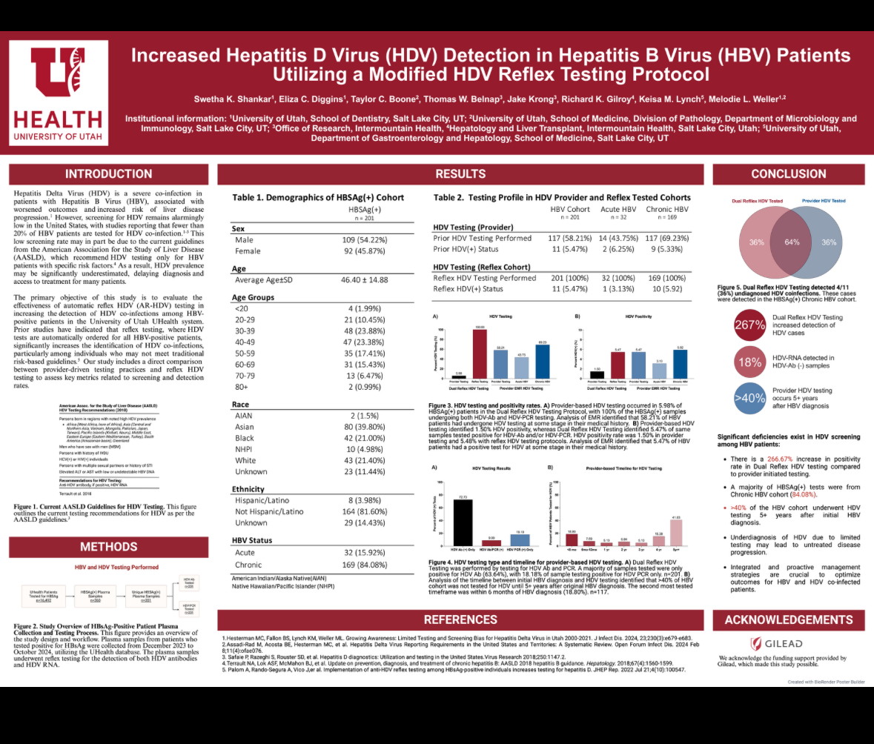

Slide 16
Implementation of
HBsAg to HDV Ab Reflex Testing in a
New York City Health System
Anna Mageras, Damodara Rao Mendu, Maria McGuire, Lauren Alpert,
Jimmy Wu, Kristie Heiden, Michael Fisher, Nina Rodriguez,
Cecilia Katzenstein, Andrea D. Branch, Douglas T. Dieterich,
Tatyana Kushner
Anna Mageras, MPH
Director, Population Health and Research
Division of Liver Diseases
Icahn School of Medicine at Mount Sinai, New York, NY

Slide 17
Disclosures
This work was funded in part by a SPEARHEAD grant from Gilead Sciences Inc.
Consulting/Ad Boards: Gilead, NOVO Nordisk, The Kinetix Group

Slide 18


Background
Hepatitis Delta virus (HDV) is most severe form of viral hepatitis.¹
  HDV requires hepatitis B virus (HBV) for replication.
U.S. HDV Ab prevalence among HBsAg+ ~4.6–11.8%. ^{2,3}
  ~25% of U.S. HDV is in NYC Metro Area. ³
2021–2023 in the Mount Sinai Health System (MSHS), only 54% of HBsAg+ patients received HDV Ab testing.⁶
New HDV treatments on the horizon → need for better screening.
New York
16.3%
Prevalence of HDV among HBV population by U.S. state.²
Brunetto MR, et al., Journal of Hepatology, 2023.
Gish RG, et al., Hepatology, 2024.
Martins EB, et al., DDW 2017.
Alpert L, et al., EASL 2023.
Notes:
5 of top 10 U.S. hot spots are in NYC
Hepatitis Delta virus (HDV) requires hepatitis B virus (HBV) surface antigen (HBsAg) for viral entry.
Progresses to cirrhosis in 5 years, HCC in 10 years.
There is limited data about implementation of HDV reflex testing in U.S. health systems.
We evaluated the steps that were required to implement a reflex test to improve guideline-concordant HDV Ab screening.
Ideally, positive HBsAg result will prompt automatic order of HDV testing
Currently, would have to remove the original label, split the sample, and place a research order as a separate process
This would require manual work from the lab team and/or research team
Can keep samples for 2-3 days
Test available at baseline: We only have HDV PCR qual which we send to ARUP who in turn forwards to QUEST. For the antibody, we have HDV, Total which is orderable in EPIC as “HEPATITIS D VIRUS (HDV) TOTAL”
Westbrook, et al. J Hepatology. 2014; Fattovich, et al, Seminars in Liver Diseases. 2003; Nourredin, et al. Curr Gasterol Rep. 2013.
Wasuwanich P, et al. Hepatitis D-associated hospitalizations in the United States: 2010-2018. AASLD, The Liver Meeting, November 12-15, 2021. Abstract 225.

Slide 19
.
Model Viral Hepatitis Screening Interventions
.
.
.
HBsAg +
HDV Ab
A few health systems, mostly in Europe, have HBsAg+ to HDV Ab reflex testing.
  HDV Ab screening rates increased from 8–35% at baseline to 64–100% with reflex.¹⁻⁴
Our health system has prior experience with viral hepatitis screening programs:
  Increased HCV RNA follow-up testing from 64% to 100% via reflex.
  Increased HBV screening from 3% to ~20% via “Care Gap” prompt for primary care providers (PCPs) in EPIC electronic medical record (EMR).⁵
Palom A, et al., JHEP Rep, 2022.
Hilleret MN, et al., JHEP Rep, 2024.
Parfut A, et al., J Clin Virol, 2024.
Cossiga V, et al., Liver International, 2023.
Mageras A, et al., EASL 2023.
Notes:
Reflex testing = a testing algorithm where an initial test is performed. Then if that test result is positive, a predetermined follow-up test is performed automatically by the lab without an additional order or blood draw.

Slide 20
Aims
Improve HDV Ab screening rates among HBsAg+ patients in our large, urban, multicenter health system by implementing HBsAg to HDV Ab reflex testing.
Evaluate impact of reflex testing on HDV Ab screening rate.
Provide a case study to other health systems in the U.S. seeking to implement HBV to HDV reflex testing.

Slide 21

MSHS Liver Population Health Infrastructure
Identifying Patients with Liver Disease
Screening by PCPs & ED via EMR tools
Navigation to
Liver Care
Referrals to Liver
Keeping Patients Engaged
Care coordinators: insurance, pharmacy, education, referrals
Provider & patient education
Case-finding algorithms*
Patient navigators: outreach education, scheduling, addressing barriers
EMR data reports
HDV Community Advisory Board
Outreach to LTFU
See poster:
Hospital (340B) and foundation/industry grant funding.
www.mountsinai.org/hepatitis

Slide 22
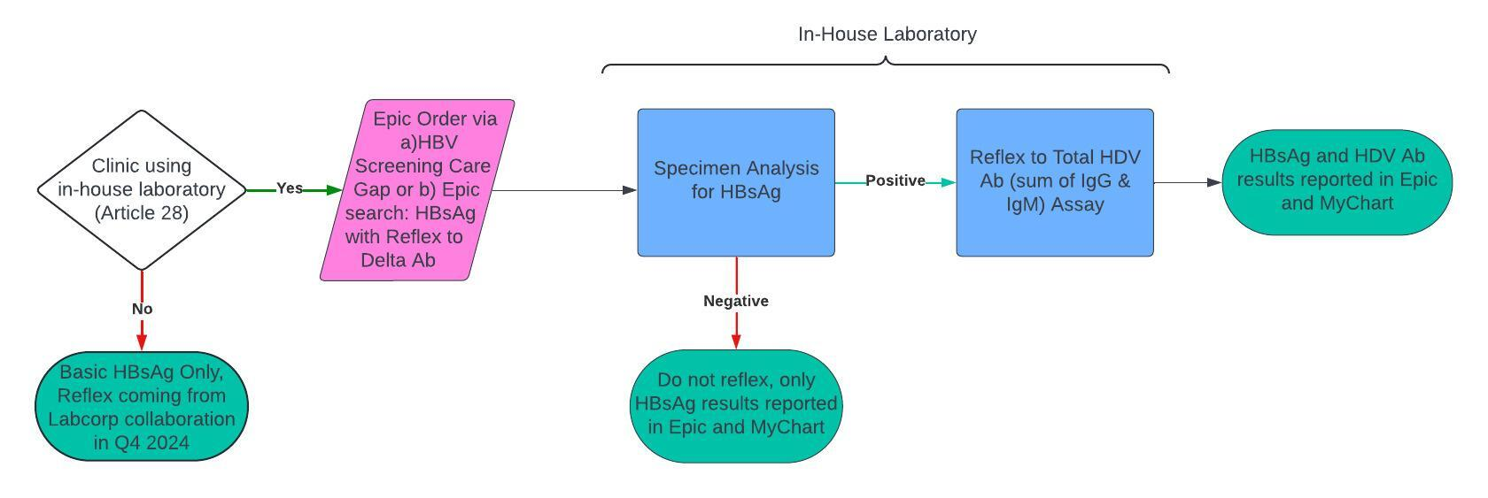
Reflex Test Logic Flow
EPIC = electronic medical record used by most of MSHS
MyChart = online portal that makes test results directly available to patients
Notes:
Our logic for this test is mapped out here: The reflex test is available to clinics using Mount Sinai’s in-house lab.
Providers in those clinics can order the reflex in our EPIC EMR either via the Hep B Screening prompt that shows up for patients never previously screened for Hep B, or they can search for it in EPIC.
First the lab runs the HBsAg test. If the result is positive, the lab then automatically runs the HDV Ab test without an additional order or blood draw. Both results are reported in the EPIC EMR and MyChart patient portal. If the HBsAg result is negative, the HDV Ab test is not run.
Some Mount Sinai clinics send out all of their lab orders. This reflex was developed for those clinics that use the in-house laboratory.
566 in-house departments (31%)
1247 FPA send-out (69%)

Slide 23
Challenges Encountered in Implementation Process
Challenge | Solution
No FDA-approved HDV Ab assay. | New York State approval.
No in-house HDV Ab test. | Validate commercially available Total HDV Ab IgG and IgM assay for in-house use. Assay method: Competitive enzyme immunoassay (ELISA). Manufacturer: International Immuno-Diagnostics.
Compliance concerns about need for patient consent. | Test labelled as reflex; no surprise to provider or patient. Option to order standalone HBsAg. Involved HDV Community Advisory Board in decision.
“HEP B AG W/RFLX HEP D AB” order hard to find in EMR. | Add search terms in EPIC EMR.
Notes:
There was a hypothetical option to reflex all HBsAg+ samples to HDV Ab on the backend, regardless of which HBsAg test a provider ordered. Our legal compliance department stated that providers must know they are ordering the reflex to ensure patient consent and have an option to order a standalone HBsAg test without the reflex due to possible insurance constraints.
We also sought input from our HDV community advisory board; this is a group of patients who provide feedback on our efforts to improve HDV care. They emphasized that it’s important to label the reflex test as such so as not to surprise the provider and patient and to maintain trust and transparency.
So our reflex test is labeled as such, and standalone HBsAg orders remain as alternatives.

Slide 24
Implementation Timeline of HDV Reflex Testing in MSHS
Background Research
Q3 2021
Address Compliance Concerns
Q3 2023
Buy-In & Approvals
Q3 2021–Q1 2023
Grant Funding
Q4 2022–Q2 2023
Validate Commercially Available HDV Ab Assay
Q3–Q4 2023
New York State Approval of HDV Ab Assay
Q4 2023
Rollout
Q1 2024
EPIC Build
Q1 2024
Billing Infrastructure
Q1 2024
Lab Setup
Q1 2024
Provider Engagement
Q2 2024
Notes:
This is a roadmap of our initiative, showcasing the long process to implement of HBV to HDV Ab reflex testing, starting with background research in Q3 of 2021; to securing buy-in from hospital leadership and primary care; getting grant funding; validating the HDV Ab assay; finalizing the logic and addressing compliance concerns; securing NYS approval; setting up the lab, EMR, and billing infrastructure; to rollout; and finally ongoing provider engagement.

Slide 25

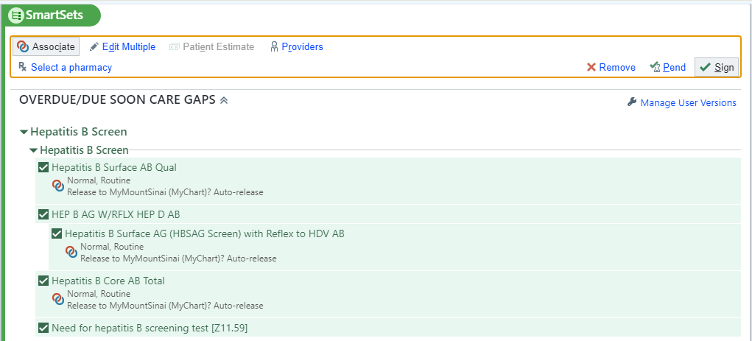
Ordering from the Care Gap Tab in EPIC EMR
Notes:
This next slide is a screenshot of our universal hep B screening prompt in the EPIC “Care Gaps” section, which shows up for primary care providers if a patient has never been screened for Hep B before.
The relevant order set now includes the HBsAg with reflex to HDV Ab order instead of the standalone HBsAg, further integrating the reflex into existing screening workflows. The provider can choose to unclick that option and order the standalone instead, but this prepopulated option shows that the reflex is the recommended test and streamlines the ordering process.

Slide 26
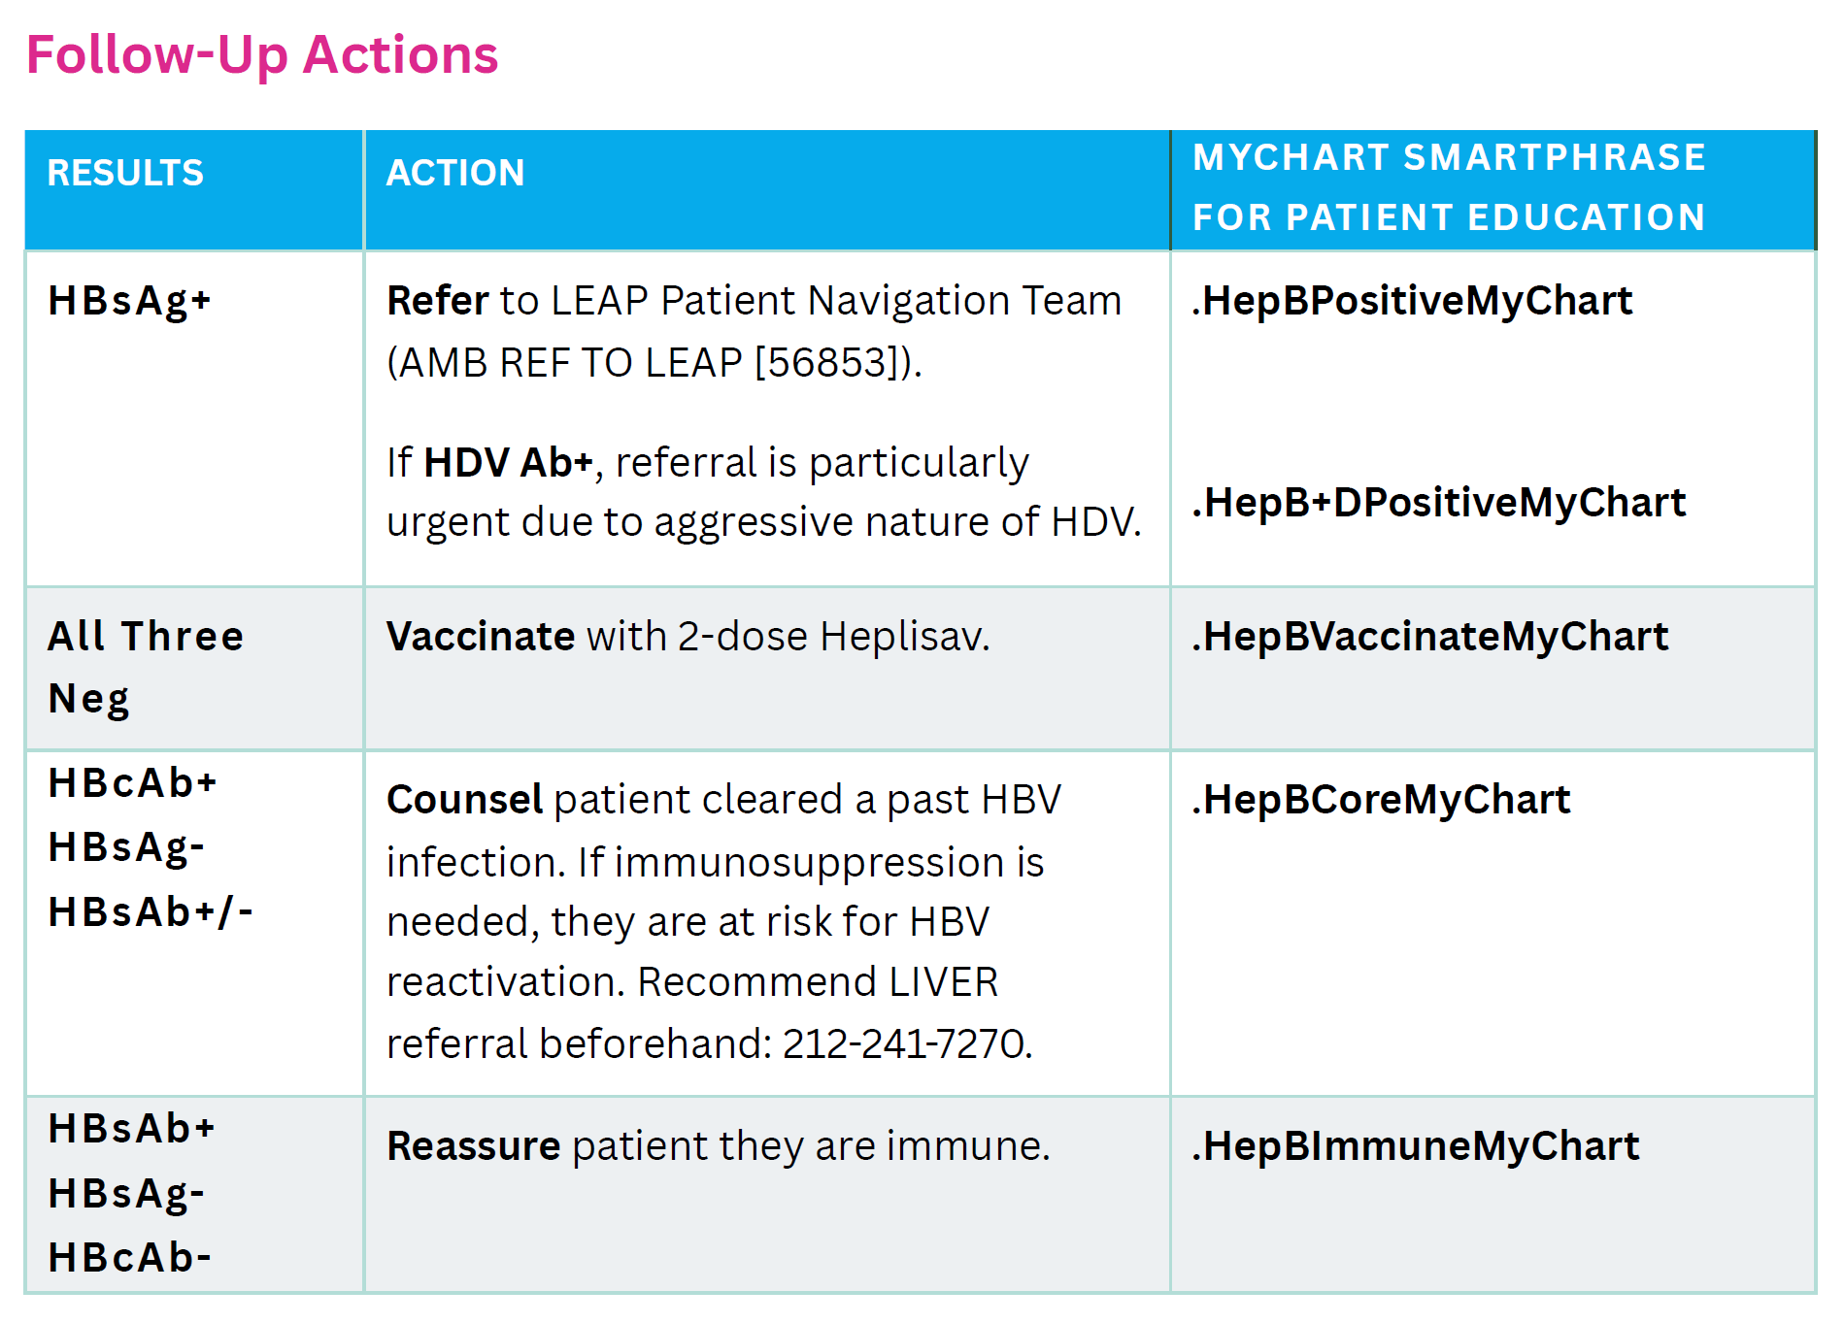
Provider Tip Sheet
Notes:
Next is a screenshot of part of our provider tip sheet, which we circulated after roll-out to educate primary care about the new reflex test and implications. We also provided a template for PCPs with language to explain the test result to their patients via MyChart message.

Slide 27
HDV Ab Screening Rate Among HBsAg+ Unique Patients
Median time from HBsAg order to HDV Ab result
13.5 days
Median time from HBsAg order to HDV Ab result
2.5 days
Notes:
Our initial results span from reflex rollout in March of 2024 through October. As you can see, during this time, 100% of HBsAg+ patients who received the HBsAg with reflex to HDV Ab test received follow-up HDV Ab testing compared to only 48% of HBsAg+ patients who received a standalone HBsAg test and required a manual HDV Ab follow-up order.
The time from HBsAg order to HDV Ab result is much shorter for patients who got the reflex at 2.5 days compared to 13.5 days for the manual follow-up order.

Slide 28
HBsAg to HDV Ab Reflex Testing Cascade, Unique Patients
March – October 2024
Notes:
This is the cascade of about 2200 unique patients who received the reflex order. 35 or 1.6% of them were HBsAg-positive, all 35 received the HDV Ab test, and one of them was HDV Ab-positive. She had known about her chronic HBV diagnosis but had not previously been tested for and was promptly referred to hepatology by her primary care provider. RNA testing by her hepatologist revealed she did not have an active delta viral load but she is being monitored now.

Slide 29
Reflex Testing by Department Type
Notes:
Looking at reflex orders by department type, three quarters were ordered in primary care, likely due to integration with the automated Hep B screening prompt.
We are also working with the ED to integrate the reflex into their existing STI panel and hope that will expand usage in that setting as well.

Slide 30
Reflex Uptake over Time
Integration with HBV Screening Prompt
PCP Tip Sheet
Notes:
You can see that reflex orders went up system-wide each month since roll-out, with spikes after integration with the Hep B screening prompt and after distribution of the tip sheet to all PCPs.

Slide 31
Reflex Uptake Over Time Compared to Non-Reflex HBsAg in Primary Care
Notes:
This graph shows the proportion of HBsAg tests ordered in primary care that are reflex in light green versus standalone in dark green. The reflex makes up a larger share now than when it was first rolled out, but it seems to have plateaued around 30%. We hope this share will continue to grow as we expand provider outreach.

Slide 32
Conclusions & Future Directions
Conclusions
Reflex testing integrated into existing infrastructure can increase screening rates and reduce provider burden.
Improved efficiency in follow-up testing time.
Potential savings: can eliminate unnecessary HDV Ab tests ordered with first HBsAg test.
Future Directions
Increase provider education to expand usage.
Collaboration with LabCorp for send-out clinics (awaiting NYS/FDA approval of reflex assay).
Further reflex from HDV Ab+ to HDV PCR.
Identify diagnosed but lost-to-care HDV+ patients via case-finding algorithm.*
*Ash N, et al., AASLD TLM 2024.
Notes:
It also reduces provider burden by eliminating the need to remember the follow-up HDV Ab order and can save money by eliminating unnecessary HDV Ab tests ordered at the same time as the initial HBsAg test.

Slide 33




Acknowledgments
  Laboratory Team:
  Dr. Damodara Rao Mendu, Maria McGuire
  EPIC Team:
  Jimmy Wu, Kristie Heiden, Michael Fisher
Liver Team:
Lauren Alpert, Nina Rodriguez, Cecilia Katzenstein, Dr. Andrea D. Branch, Dr. Douglas T. Dieterich,
Dr. Tatyana Kushner
  HDV Community Advisory Board

Slide 34
HBsAg-Positive Reflex to Anti-HDV
‡
Cross-sectional analysis of HDV testing among HBsAg-positive patients at 2 London Centers, 2005-2012
HDV Testing Based on Provider Discretion or Reflex
100
99.4
Provider discretion
Reflex
80
60
Patients (%)
40.0
40
20
67
168
3543
3563
<1.0
4.5
<1.0
<1.0
0
HDV Tested
Anti-HDV
HDV RNA Positive
Center with a reflex laboratory algorithm achieved anti-HDV testing of almost all first HBsAg-positive samples over a 12-yr period
El Bouzidi. J Clin Virol. 2015;66:33.
Notes:
HBsAg, hepatitis B surface antigen; HDV, hepatitis delta virus.

